Slide 1
Measuring External Product Attributes
Chapter#10

Slide 2
QUALITY
The principal objective of software engineering is to improve the quality of software products
Software quality is difficult to judge because it depends on the beholder.
However, from a measurement perspective, we must be able to define quality in terms of specific software product attributes of interest to the user
The International Organization for Standardization (ISO) defines quality as “the totality of characteristics of an entity that bear on its ability to satisfy stated or implied needs” (ISO8042:1994). or “the degree to which a set of inherent characteristics fulfils requirements”

Slide 3
QUALITY
Other experts define quality based on conformance to requirements and fitness for use
Conformance to requirements means the fulfilment of a product, process, or service of specified written requirements.
Fitness for use means that a product can be used as it was intended
The project team must develop good relationships with key stakeholders, especially the main customer for the project, to understand what quality means to them. After all, the customer ultimately decides if the quality is acceptable.

Slide 4
QUALITY ATTRIBUTES
Maintainability
Usability
Security
Reliability
These key attributes, called quality factors, are normally high-level external attributes

Slide 5
MODELING SOFTWARE QUALITY
Early Models
Boehm software quality model
McCall software quality model
These models focus on the final product and identify key attributes of quality from the user’s perspective.
Each of the models assumes that the quality factors/attributes are still at too high a level to be meaningful or to be measured directly. Hence, they are further decomposed into lower-level attributes called quality criteria or quality subfactors.

Slide 6
BOEHM SOFTWARE QUALITY MODEL

Slide 7
McCall SOFTWARE QUALITY MODEL

Slide 8
Figure 10.3 A decomposition of maintainability

Slide 9
Six Sigma Principle
Six Sigma is a quality-control methodology that businesses use to significantly reduce defects and improve processes.
Six Sigma’s target for quality is no more than 3.4 defects, errors, or mistakes per million opportunities
It is a Philosophy/set of tools/ methodology/ metrics
Six Sigma is uniquely driven by a close understanding of customer needs, data, and statistical analysis

Slide 10
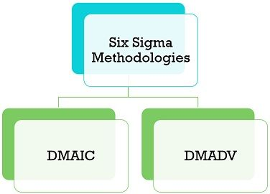
Six Sigma Methodologies

Slide 11
Six Sigma (DMAIC)
1. Define: Define the problem, opportunity/process for improvement, and customer requirements.
2. Measure: Define measures and then collect, compile, and display data. Measures are defined in terms of defects per opportunity using some metrics.
3. Analyze: Scrutinize process details to find improvement opportunities.
4. Improve: Generate solutions and ideas for improving the problem. A final solution is verified with the project sponsor, and the Six Sigma team develops a plan to pilot test the solution.
5. Control: Track and verify the stability of the improvements and the predictability of the solution.

Slide 12
Six Sigma (DMADV)
Define: The establishment of goals relating to the design activity takes place. This step is the same as the Define step in the DMAIC model.
Measure: Measure and identify critical-to-quality characteristics of the product, service or process. This includes risk and production capabilities.
Analyze: Analyze the data to find the best design
Design: Design and test the product, service or process.
Verify: Ensure that the design output meets the design input requirements (verification) and that the designed product performs satisfactorily under real or simulated conditions of intended use (validation).

Slide 13
Differences between DMAIC and DMADV
BASIS FOR COMPARISON | DMAIC | DMADV
Meaning | DMAIC is a six sigma methodology which attempts to improve the existing process. | DMADV is another six sigma methodology that seeks to design new or existing processes.
Type of Process | Reactive Process | Proactive Process
Focuses on | Process focused | Customer-focused
Team Requirement | Small Team | Large Team
Time Horizon | Short to Medium-term | Long term
Used when | Continuous improvement is required | Reengineering is required
Approach | Corrective | Preventive
Implemented when | Incremental change is needed | Evolutionary change is needed

Slide 14
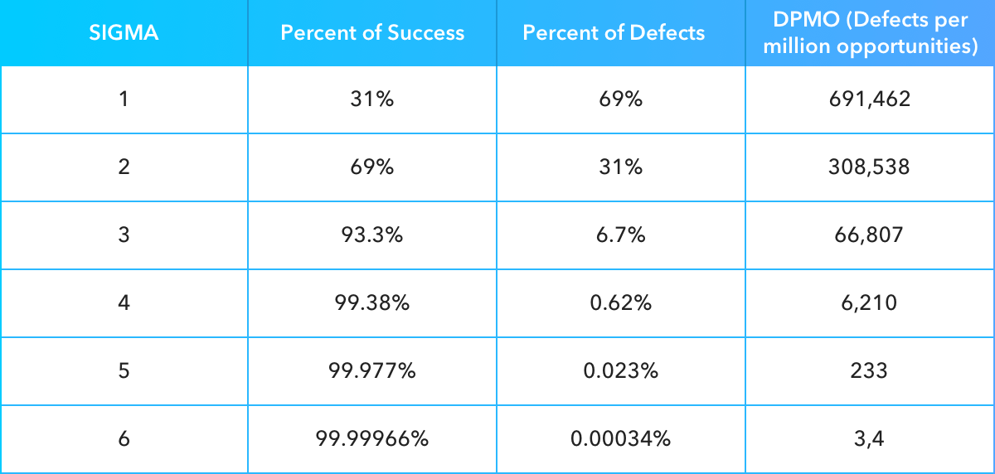
Sigma Performance Table

Slide 15
3 Sigma Vs. 6 Sigma: A case
The 3 sigma Company | The 6 sigma Company
Spends 15~25% of sales dollars on cost of failure | Spends 5% of sales dollars on cost of failure
Relies on inspection to find defects | Relies on capable process that don’t produce defects
Does not have a disciplined approach to gather and analyze data | Use Measure, Analyze, Improve, Control and Measure, Analyze, Design
Benchmarks themselves against their competitors. | Benchmarks themselves against the best in the world
Believes 99% is good enough | Believes 99% is unacceptable

Slide 16
TWO DIFFERENT WAYS
The “fixed model” approach
A fixed model refers to a predefined, structured approach to achieving and maintaining quality in software systems. These models are well-established and widely adopted in industry. (Boehm’s and McCall’s)
The “define your own quality model” approach
Do not follow the models.
Meet with prospective users to reach a consensus on which quality attributes are important

Slide 17
ISO/IEC 9126-1 and ISO/IEC 25010 Standard Quality Models
In 1992, a derivation of the McCall model was proposed as the basis for an international standard for software quality measurement and adopted.
In 2011, ISO/IEC 25010 “Systems and Software Engineering—Systems and Software Quality Requirements and Evaluation (SQuaRE)” replaced it.
In the ISO/IEC 25010 standard, software quality is defined to be the following: “The degree to which a software product satisfies stated and implied needs when used under specified conditions.”

Slide 18
ISO/IEC 25010 Standard Quality Model
The quality is decomposed into eight characteristics:
Functional suitability
Performance efficiency
Compatibility
Usability
Reliability
Security
Maintainability
Portability
Each of the eight is defined in terms of other attributes of a relevant aspect of the software, and each can be refined through multiple levels of sub-characteristics.

Slide 19
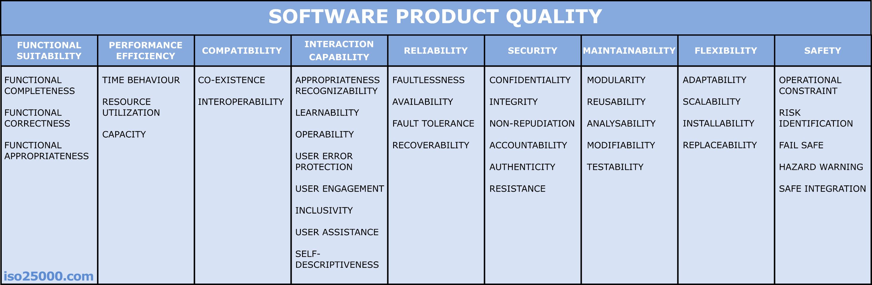
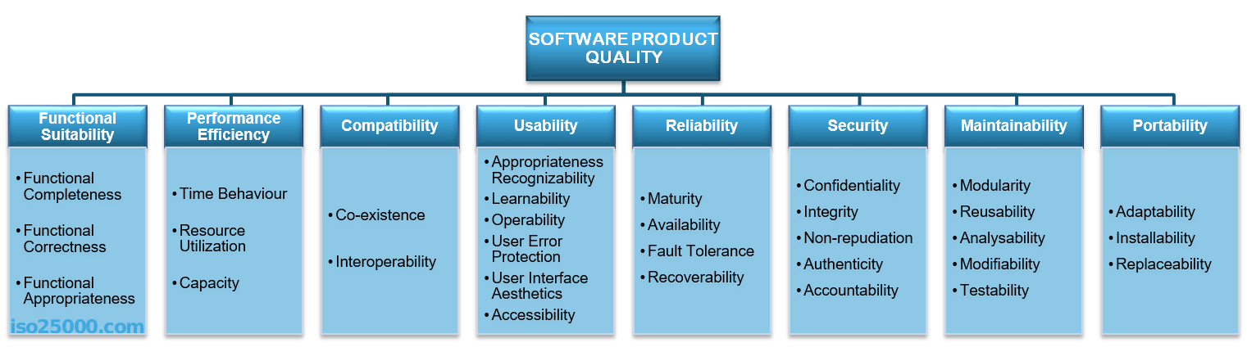
ISO/IEC 25010 Standard Quality Model
Please check
https://iso25000.com/index.php/en/iso-25000-standards/iso-25010

Slide 20
Measuring Aspect of Quality (how to measure)
Many software engineers base their quality assessments on measures defined for a specific purpose, separate from any formal quality model
For example, certain systems have stringent requirements for portability (the ability to move an application from one host environment to another) and integrity (the assurance that modifications can be made only by authorized users). The user or practitioner may offer simple definitions of these terms, such as
Portability = 1 −ET/ER
ET is a measure of the resources needed to move the system to the target environment, and ER is a measure of the resources needed to create the system for the resident environment

Slide 21
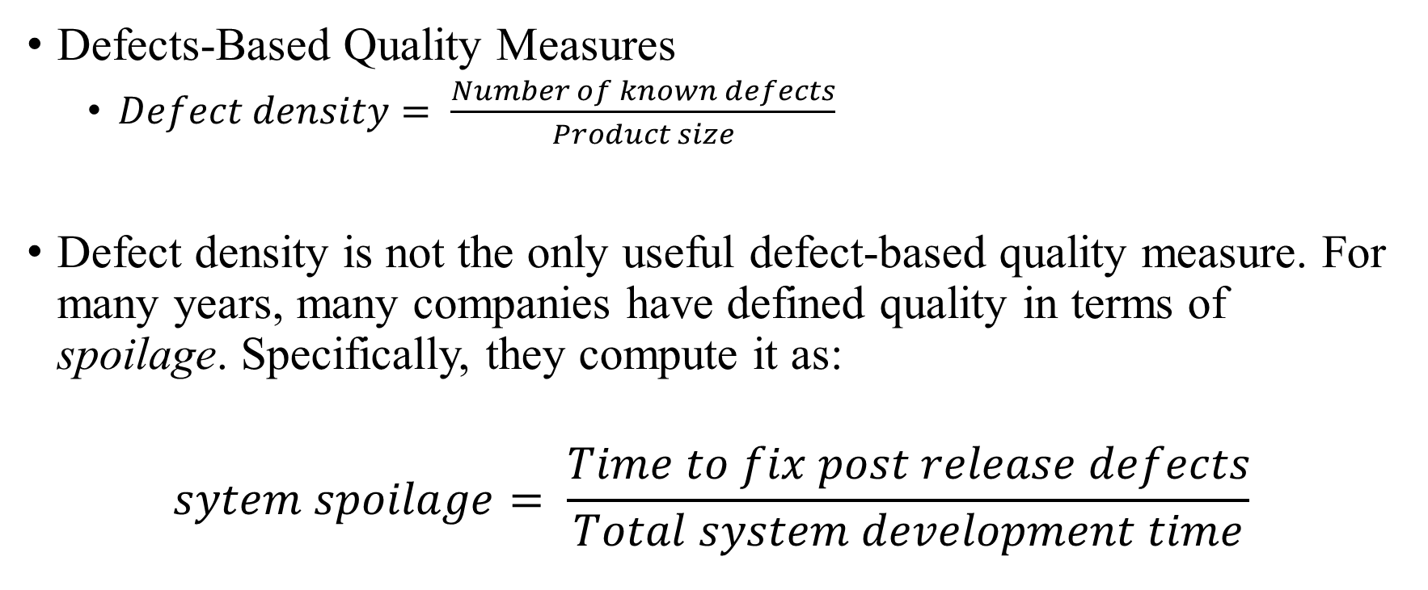
Measuring Aspect of Quality (how to measure)
Defects-Based Quality Measures
$Defect density= \frac{Number of known defects}{Product size}$
Defect density is not the only useful defect-based quality measure. For many years, many companies have defined quality in terms of spoilage. Specifically, they compute it as:
$$sytem spoilage= \frac{Time to fix post release defects}{Total system development time}$$

Slide 22
Common Vulnerability Scoring System (CVSS)
The Common Vulnerability Scoring System (CVSS) is a free and open industry standard for assessing the severity of computer system security vulnerabilities
It is a widely used method, developed by the Forum of Incident Response and Security Teams (FIRST). The CVSS base metric group can have a score between zero and one, with zero representing no vulnerability and one representing the maximum vulnerability.
It consists of three main metric groups: Base, Temporal, and Environmental. In turn, each of these groups consists of a set of metrics.
The base metric group includes six individual measures related to the required access to exploit the vulnerability and the impact of the vulnerability
Scores are calculated based on a formula that depends on several metrics that approximate the ease and impact of an exploit. Scores range from 0 to 10, with 10 being the most severe
The current version of CVSS (CVSSv3.1) was released in June 2019.

Slide 23
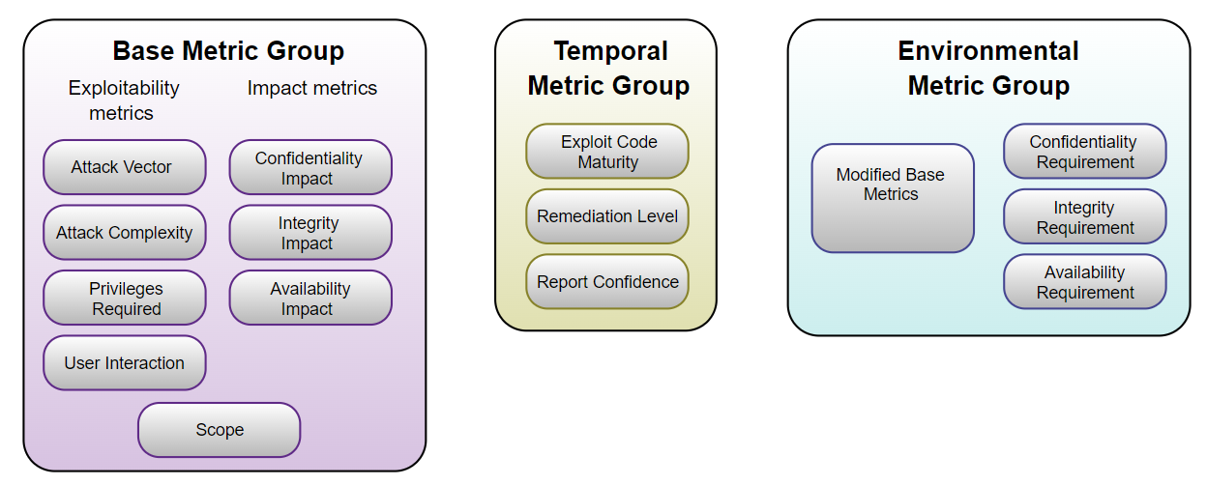
Common Vulnerability Scoring System (CVSS)

Slide 24
Common Vulnerability Scoring System (CVSS)
The Base Score reflects the severity of a vulnerability according to its intrinsic characteristics which are constant over time and assumes the reasonable worst-case impact.
The Temporal Metrics adjust the Base severity of a vulnerability based on factors that change over time, such as the availability of exploit code.
The Environmental Metrics adjust the Base and Temporal severities to a specific computing environment. They consider factors such as the presence of mitigations in that environment.

Slide 25
Common Vulnerability Scoring System (CVSS)
Access Vector (AV) indicates how remote an attacker can be to exploit the vulnerability.
Value | Description | Score
Local (L) | The attacker must either have physical access to the vulnerable system (e.g. firewire attacks) or a local account | 0.395
Adjacent Network (A) | The attacker must have access to the broadcast or collision domain of the vulnerable system (e.g. ARP spoofing, Bluetooth attacks). | 0.646
Network (N) | The vulnerable interface is working at layer 3 or above of the OSI Network stack. These types of vulnerabilities are often described as remotely exploitable (e.g. a remote buffer overflow in a network service) | 1.0

Slide 26
Common Vulnerability Scoring System (CVSS)
2. Access Complexity (AC) indicates how complex the attack method needs to be in order to mount a successful attack.
Value | Description | Score
High (H) | Specialised conditions exist, such as a race condition with a narrow window, or a requirement for social engineering methods that would be readily noticed by knowledgeable people. | 0.35
Medium (M) | There are some additional requirements for the attack, such as a limit on the origin of the attack, or a requirement for the vulnerable system to be running with an uncommon, non-default configuration. | 0.61
Low (L) | There are no special conditions for exploiting the vulnerability, such as when the system is available to large numbers of users, or the vulnerable configuration is ubiquitous. | 0.71

Slide 27
Common Vulnerability Scoring System (CVSS)
3. Authentication (Au) indicates whether an attacker needs to authenticate two or more times
Value | Description | Score
Multiple (M) | Exploitation of the vulnerability requires that the attacker authenticate two or more times, even if the same credentials are used each time. | 0.45
Single (S) | The attacker must authenticate once in order to exploit the vulnerability. | 0.56
None (N) | There is no requirement for the attacker to authenticate. | 0.704

Slide 28
Common Vulnerability Scoring System (CVSS)
4. The Confidentiality (C) metric describes the impact on the confidentiality of data processed by the system.
Value | Description | Score
None (N) | There is no impact on the confidentiality of the system. | 0.0
Partial (P) | There is considerable disclosure of information, but the scope of the loss is constrained such that not all of the data is available. | 0.275
Complete (C) | There is total information disclosure, providing access to any / all data on the system. Alternatively, access to only some restricted information is obtained, but the disclosed information presents a direct, serious impact. | 0.660

Slide 29
Common Vulnerability Scoring System (CVSS)
5. Integrity Impact (I) indicates whether there is no impact to the system integrity
Value | Description | Score
None (N) | There is no impact on the integrity of the system. | 0.0
Partial (P) | Modification of some data or system files is possible, but the scope of the modification is limited. | 0.275
Complete (C) | There is total loss of integrity; the attacker can modify any files or information on the target system. | 0.660

Slide 30
Common Vulnerability Scoring System (CVSS)
6. The Availability (A) metric describes the impact on the availability of the target system. Attacks that consume network bandwidth, processor cycles, memory, or any other resources affect the availability of a system
Value | Description | Score
None (N) | There is no impact on the availability of the system. | 0.0
Partial (P) | There is reduced performance or loss of some functionality. | 0.275
Complete (C) | There is total loss of availability of the attacked resource. | 0.660

Slide 31
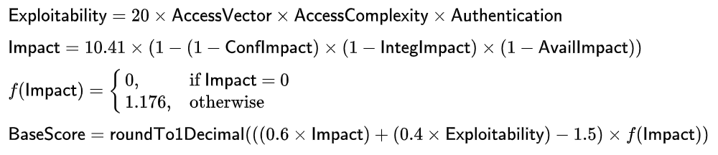
Calculation
These six metrics are used to calculate the exploitability and impact sub-scores of the vulnerability. These sub-scores are used to calculate the overall BaseScore.

